Slide 1

Doppelgänger Testing for Autonomous Driving Software
Doppelgänger
Yuqi Huai*, Yuntianyi Chen*, Sumaya Almanee*,
Tuan Ngo⁺, Xiang Liao*, Ziwen Wan*,
Qi Alfred Chen*, Joshua Garcia*
* University of California, Irvine
+ VNU University of Engineering and Technology

Slide 2

Doppelgänger
a second self or different version of oneself
a ghostly counterpart of a living person

Slide 3
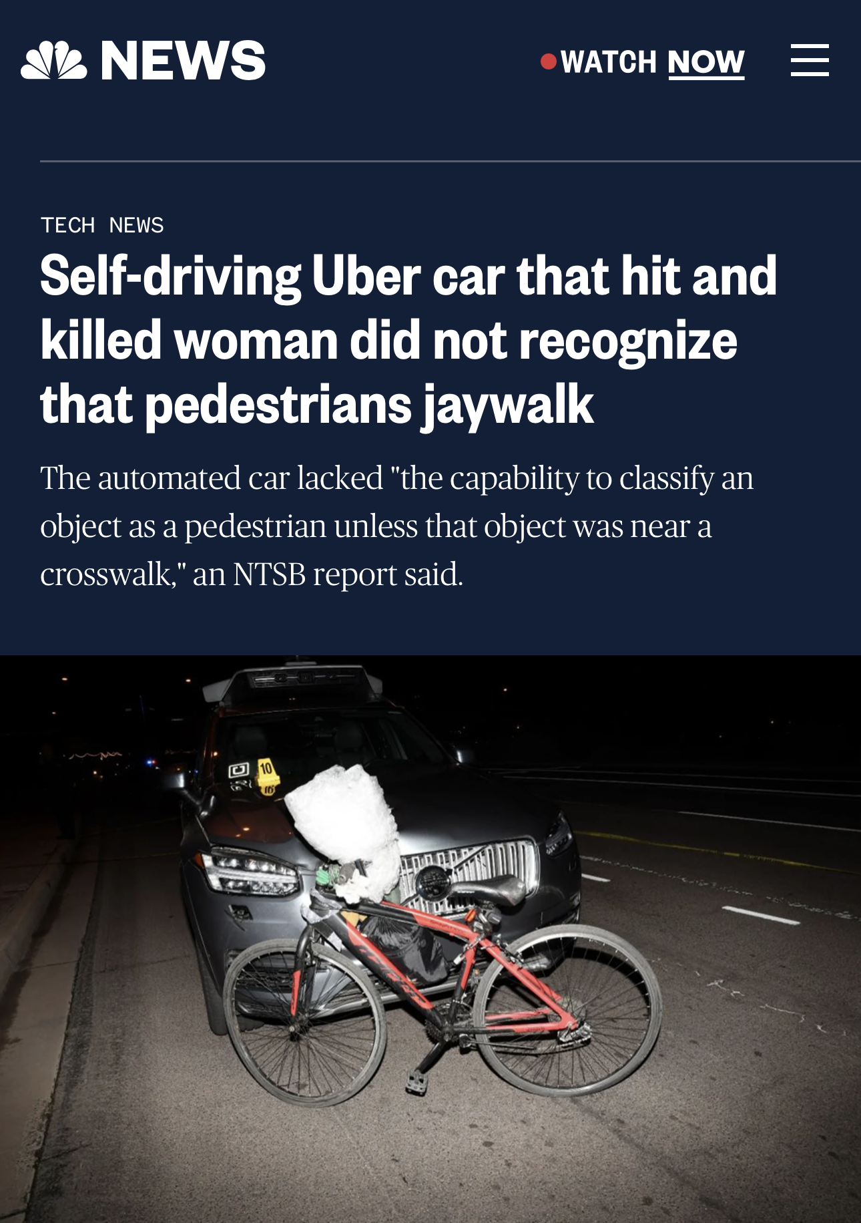
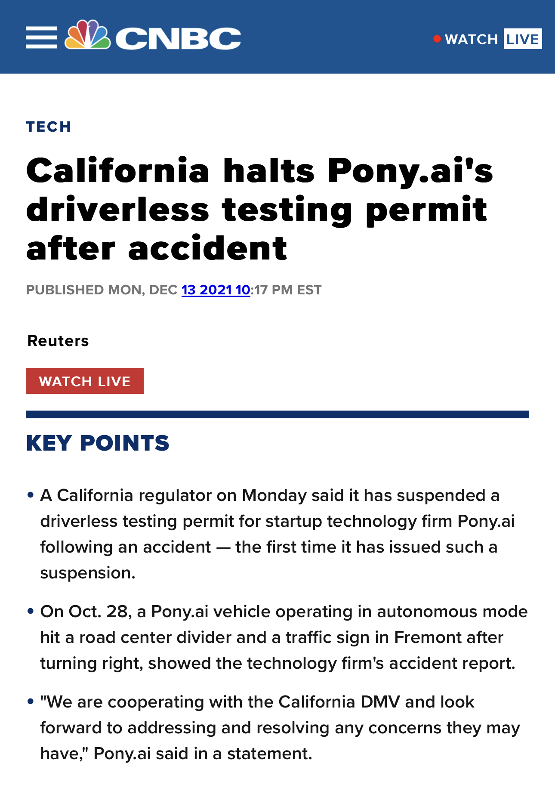
Autonomous Driving Software (ADS)
a.k.a. autonomous vehicle
Promising benefits:
Fewer crashes
Increased mobility
etc.
Safety concern remains.
MAR 2018
NOV 2021
Ensuring American Leadership in Automated Vehicle Technologies: Automated Vehicles 4.0
Notes:
https://www.nbcnews.com/tech/tech-news/self-driving-uber-car- hit-killed-woman-did-not-recognize-n1079281
https://www.cnbc.com/2021/12/14/california-halts-ponyais-driverless- testing-permit-after-accident.html

Slide 4



ADS Testing
Field-Operational
Requires Permit.
Simulation-Based
Does not require permit.
https://www.dmv.ca.gov/portal/vehicle-industry-services/autonomous-vehicles/autonomous-vehicle-testing-permit-holders/
Notes:
- 40 companies have permit for testing with a driver
- 7 companies have permit for driverless testing

Slide 5
Related Approaches
AV-FUZZER (ISSRE’20)
MOSAT (FSE’22)
CRISCO (ASE’22)
AutoFuzz (TSE’23)
Common Aspects:
Single AV and 2-4 obstacles.
Focus on finding ADS collisions.
collisions

Slide 6
Do all collisions effectively reveal ADS bugs?
collisions
revealing
bugs

Slide 7


Scenario #1: Side-impact
The AV and the obstacle cruising side-by-side.

Slide 8
Scenario #1: Side-impact
The obstacle forces a lane change.
The AV has the right-of-way, and the obstacle is fully responsible.
Does Not reveal an ADS bug.
No ADS misbehavior.

Slide 9
Scenario #2: Left-turn
The AV and the obstacle are coming from different directions.

Slide 10
Scenario #2: Left-turn
The AV turns left.
The obstacle has the right-of-way, and the AV is fully responsible.
Scenario reveals ADS bug.
ADS misbehavior exists.
responsible
reveals
misbehavior

Slide 11
responsible
An ADS being responsible indicates its misbehavior, thus reveals an ADS bug.
misbehavior
revealing

Slide 12



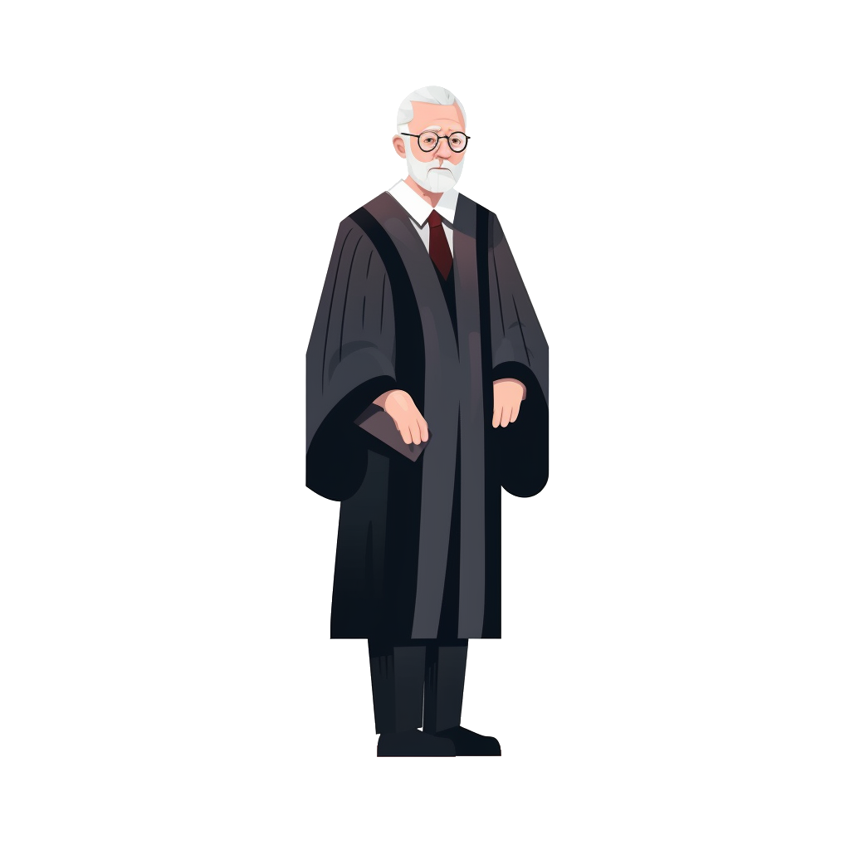
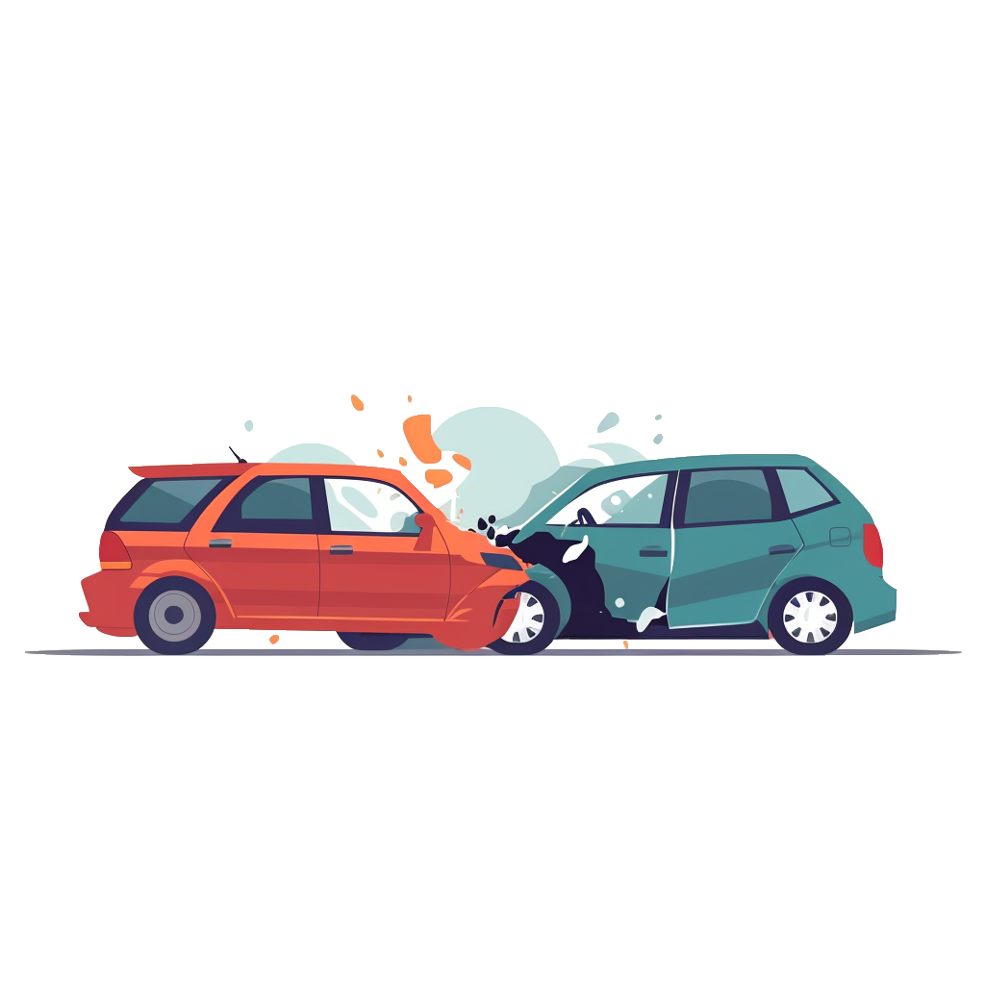
Determining Responsibility Is Hard
Police Citations
Insurance
Investigations
Lawsuits
https://www.forbes.com/advisor/car-insurance/determining-fault-after-accident/

Slide 13




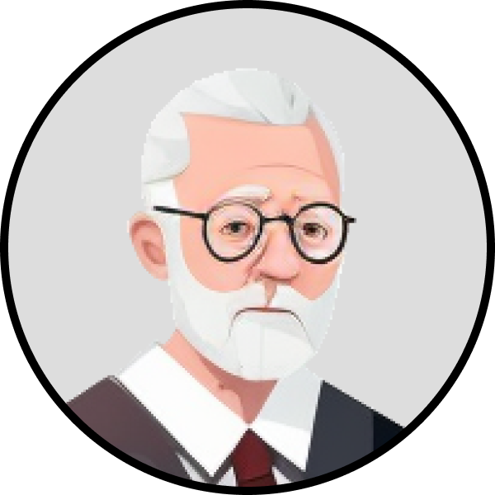
Determining Responsibility Naïve Approach #1: Experts On Call
bug_revealing = []
while True:
scenario = run_scenario()
if detect_collision(scenario):
if call_police(scenario) or \
call_insurance(scenario) or \
call_judge(scenario):
bug_revealing.append(scenario)
else:
print(“Not Bug Revealing!”)

Slide 14
Determining Responsibility Naïve Approach #1: Experts On Call
bug_revealing = []
while True:
scenario = run_scenario()
if detect_collision(scenario):
if call_police(scenario) or \
call_insurance(scenario) or \
call_judge(scenario):
bug_revealing.append(scenario)
else:
print(“Not Bug Revealing!”)
Too Much Manual Work Involved!

Slide 15
Determining Responsibility Naïve Approach #2: Improve Obstacle Modeling
Use a sophisticated obstacle modeling that:
Drives realistically.
Respects all traffic laws.
Respects right-of-way rules.
Reacts properly to other road-traffic participants.
Never be responsible for causing violations.
Exactly the requirements an ADS should meet!

Slide 16
Determining Responsibility Naïve Approach #2: Improve Obstacle Modeling
Use a sophisticated obstacle modeling that:
Drives realistically.
Respects all traffic laws.
Respects right-of-way rules.
Reacts properly to other road traffic participants.
Never be responsible for causing violations.
Exactly the requirements for an ADS to be perfect!
Perfect Obstacles Does Not Exist Yet!

Slide 17
Doppelgänger Testing

Slide 18
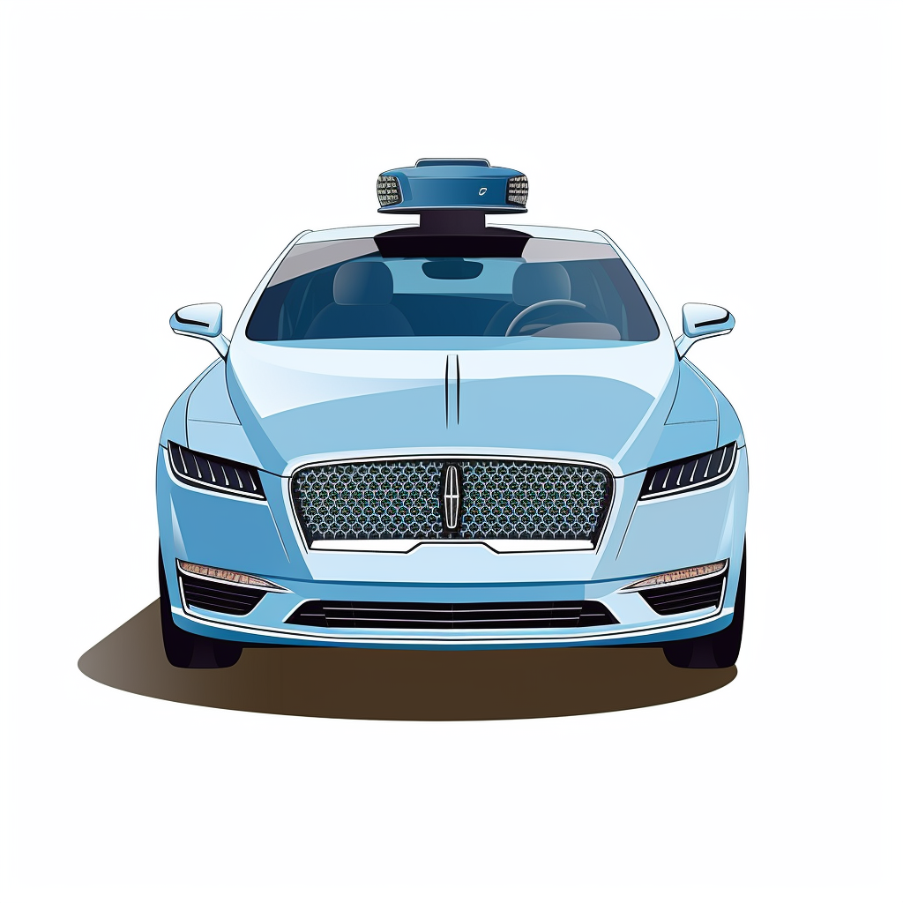
Doppelgänger Testing
Let the ADS control every vehicle in the simulation!
If collision occurs, one of the AVs must be responsible, thus revealing a bug in the ADS.

Slide 19
Doppelgänger Testing
Doppelgänger
Testing
Given the same scenarios ...
Prior Approach:
Which car is the AV?
Is it responsible?
Doppelgänger Testing:
Which AV is responsible?

Slide 20


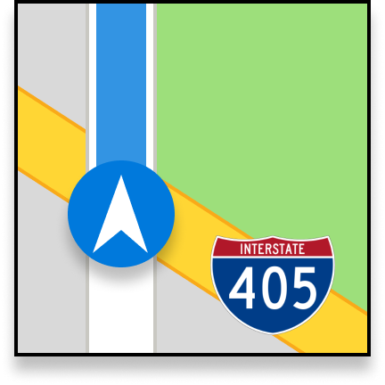






DoppelTest
Doppelgänger
Testing
HD Map
Map Parser
Doppelgänger Orchestrator
Recorded
Scenarios
localization
perception
AV 1
Message
Broker
Scenario
Generator
Analyzer
Scenario Representation
AV 2
...
https://github.com/YuqiHuai/DoppelTest, https://zenodo.org/record/7657587

Slide 21


Doppelgänger
Map Parser
Testing
Analyzes HD Map used by the ADS.
Identifies:
Valid locations of road-traffic participants.
Conflicts between signals at every junction.

Slide 22
DoppelTest
Doppelgänger
Testing
HD Map
Map Parser
Doppelgänger Orchestrator
Recorded
Scenarios
localization
perception
AV 1
Message
Broker
Scenario
Generator
Analyzer
Scenario Representation
AV 2
...
https://github.com/YuqiHuai/DoppelTest, https://zenodo.org/record/7657587

Slide 23




DoppelTest
Scenario
Generator
Doppelgänger
Testing
AV 1 (start, destination)
AV 2 (start, destination)
AV 3 (start, destination)
...
Pedestrian 1 (crosswalk)
Pedestrian 2 (crosswalk)
...
Traffic Signal Configuration (green/yellow/red-clearance interval)

Slide 24
DoppelTest
Doppelgänger
Testing
HD Map
Map Parser
Doppelgänger Orchestrator
Recorded
Scenarios
localization
perception
AV 1
Message
Broker
Scenario
Generator
Analyzer
Scenario Representation
AV 2
...
https://github.com/YuqiHuai/DoppelTest, https://zenodo.org/record/7657587

Slide 25
DoppelTest
Doppelgänger
Testing
Manages AV instances.
Initializing, resetting.
Sending routing request.
Communicates with all AV instances.
Retrieves their location.
Exchange locations between AVs.
Doppelgänger Orchestrator
localization
perception
AV 1
Message
Broker
AV 2
...

Slide 26
DoppelTest
Doppelgänger
Testing
Translates ground-truth localization into ground-truth perception.
Narrows the focus to Prediction and Planning module.
Ensures scenario validity as long as AVs can ensure realistic movement.
Doppelgänger Orchestrator
localization
perception
AV 1
Message
Broker
AV 2
...

Slide 27
DoppelTest
Doppelgänger
Testing
HD Map
Map Parser
Doppelgänger Orchestrator
Recorded
Scenarios
localization
perception
AV 1
Message
Broker
Scenario
Generator
Analyzer
Scenario Representation
AV 2
...
https://github.com/YuqiHuai/DoppelTest, https://zenodo.org/record/7657587

Slide 28
Doppelgänger
Analyzer
Testing
Analyzes
Closest distance between road-traffic participants.
Pairs of conflicting trajectories.
Unique decisions made by each of the AV instances.
Number of violations.
Reports Violations
Collision
Red-light
Stop-sign
Routing Response

Slide 29
DoppelTest
Doppelgänger
Testing
HD Map
Map Parser
Doppelgänger Orchestrator
Recorded
Scenarios
localization
perception
AV 1
Message
Broker
Scenario
Generator
Analyzer
Scenario Representation
AV 2
...
https://github.com/YuqiHuai/DoppelTest, https://zenodo.org/record/7657587
Notes:
more details, including genetic representation, formalism will be discussed in the paper

Slide 30
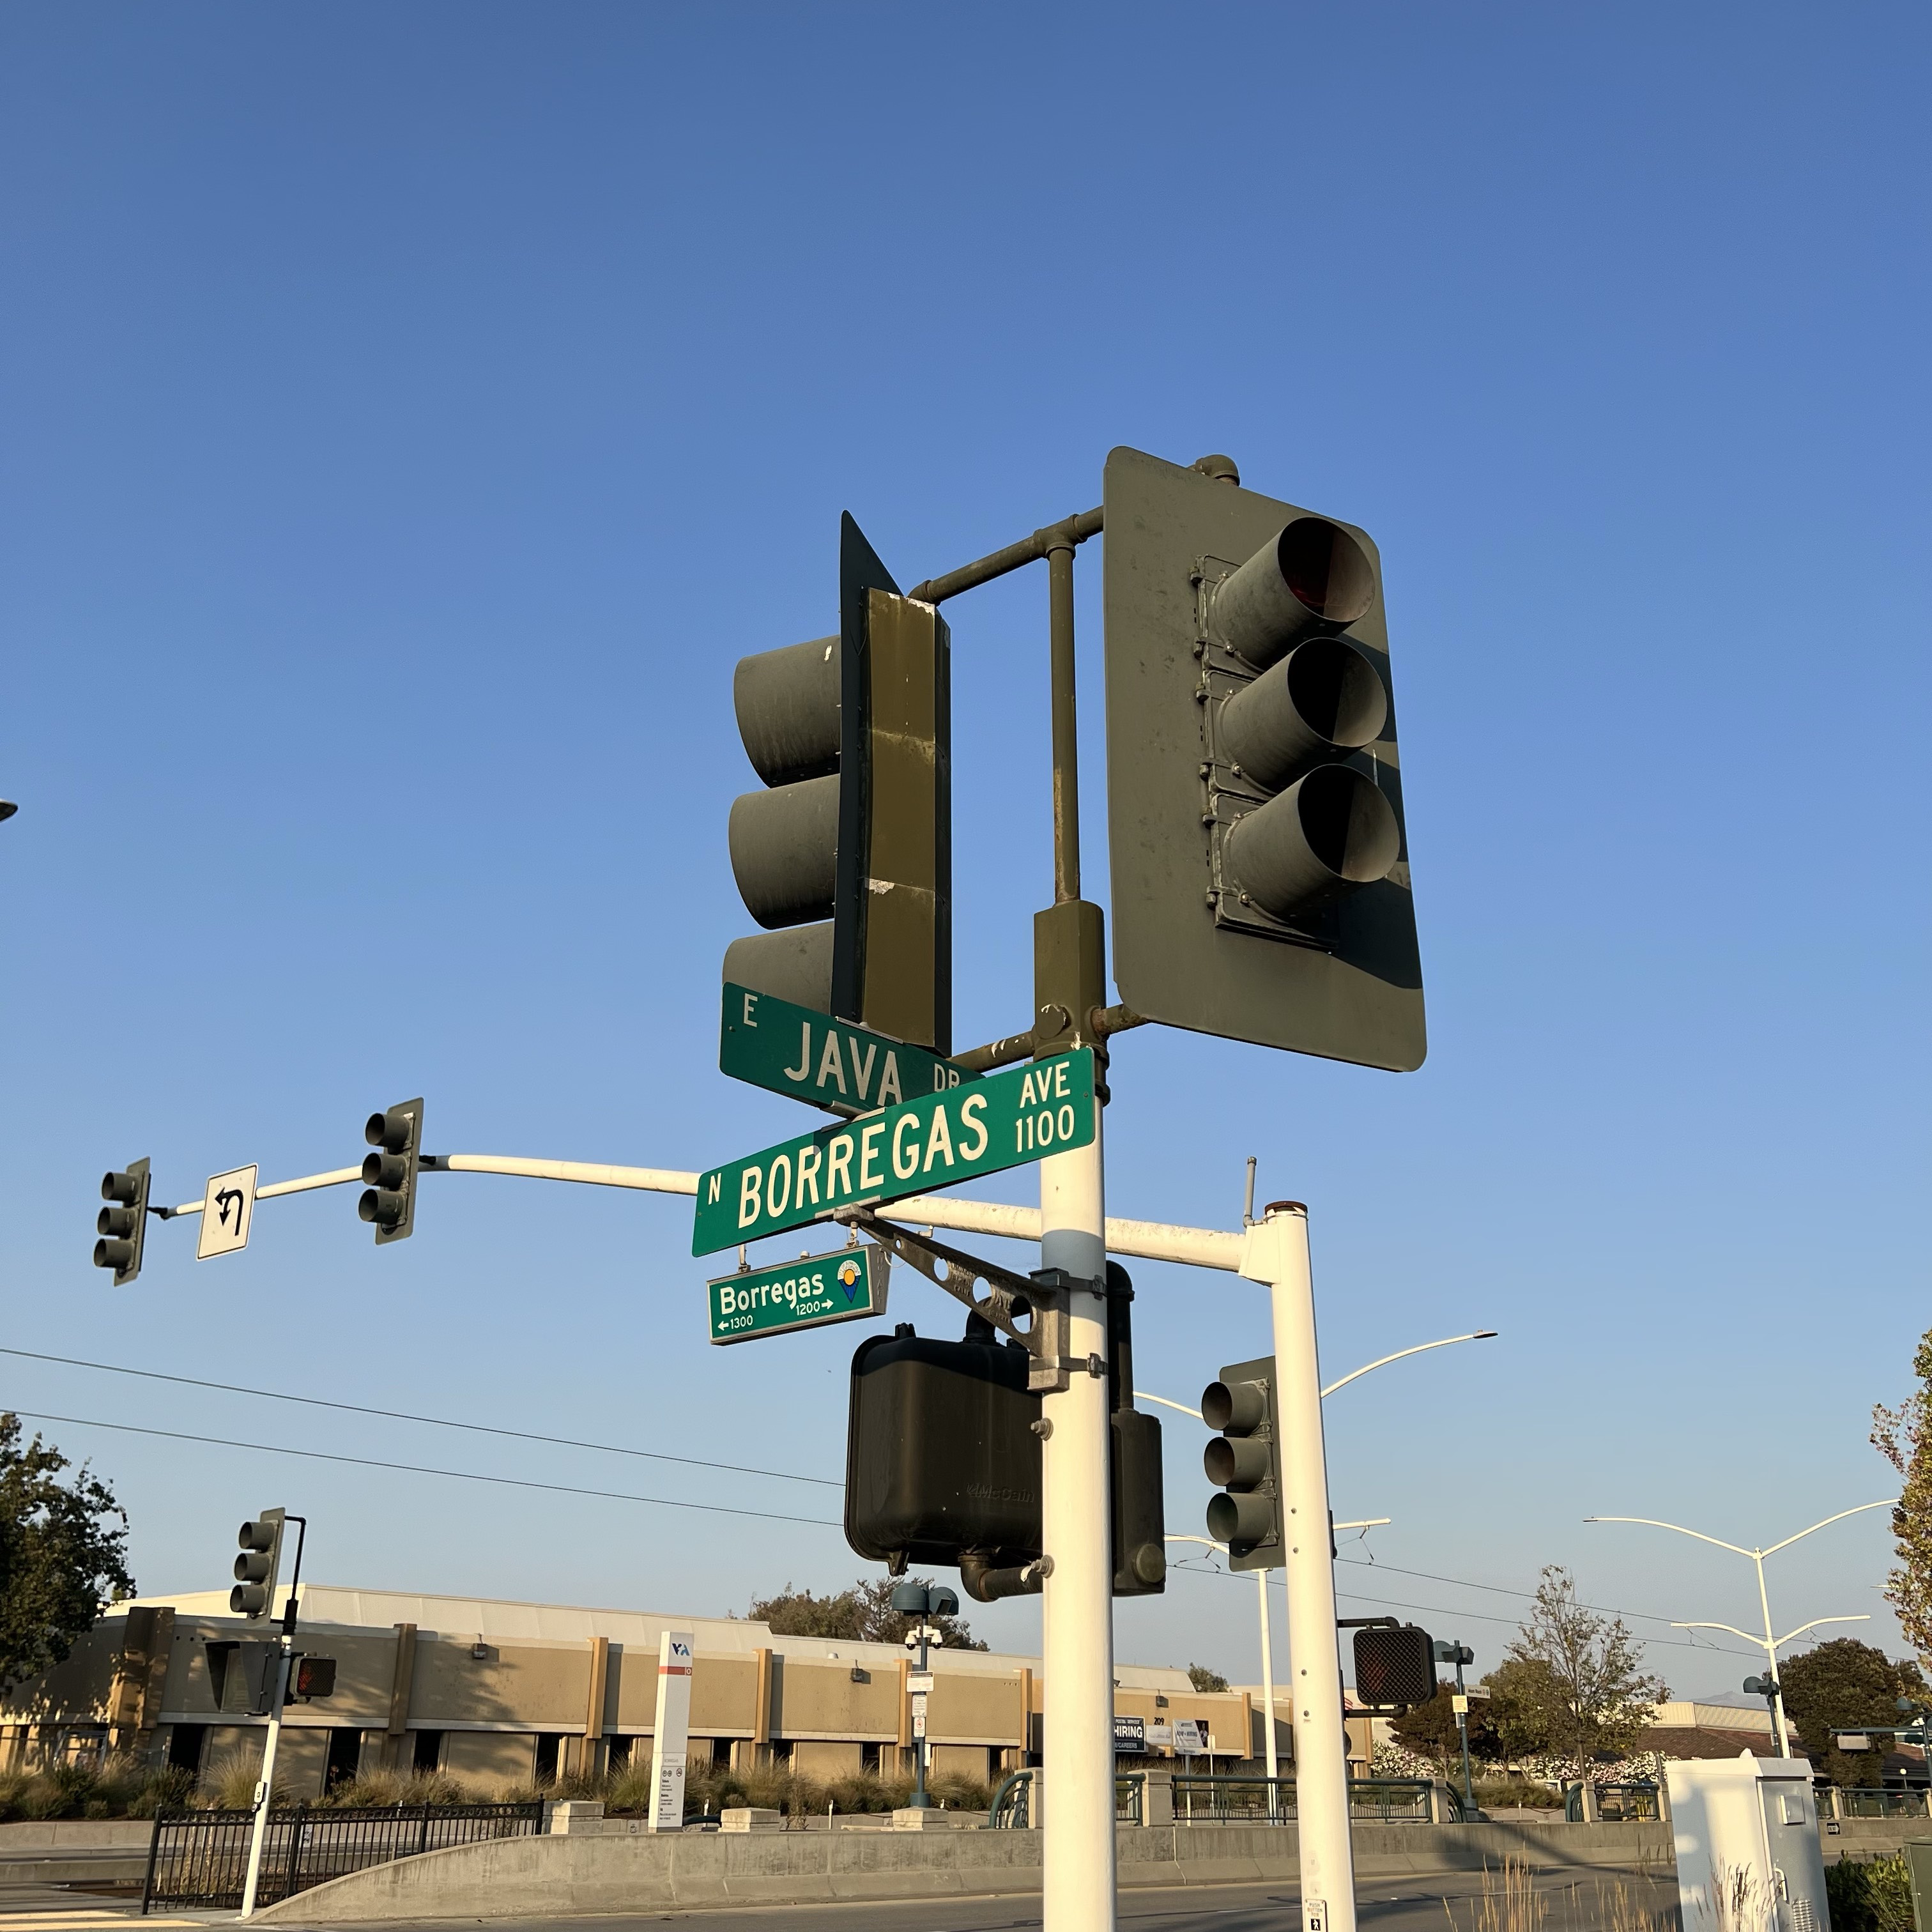

DoppelTest Evaluation
Doppelgänger
Testing
Evaluation
Generated scenarios on Borregas Avenue with Baidu Apollo 7.0
Experimented for 240 hours

Slide 31

DoppelTest Evaluation
Doppelgänger
Testing
Evaluation
Bug Description | Number
Failure to plan for slow dynamic obstacles. | 19
Failure to react to obstacle heading change. | 41
Incorrect prediction trajectory. | 12
Unsafe lane borrow decision. | 9
Improper overtake decision. | 2
Case Study: Unsafe Lane Borrow

Slide 32
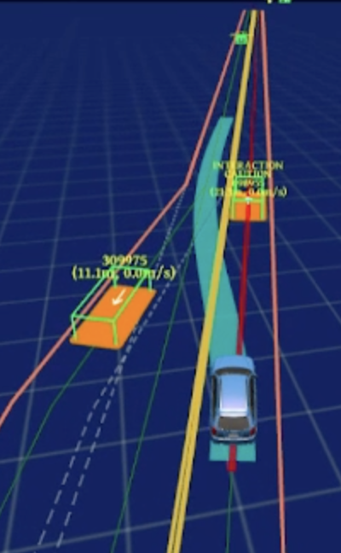
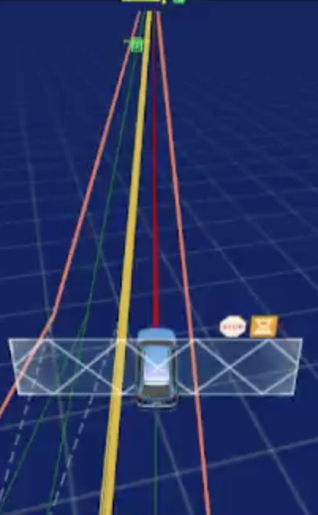
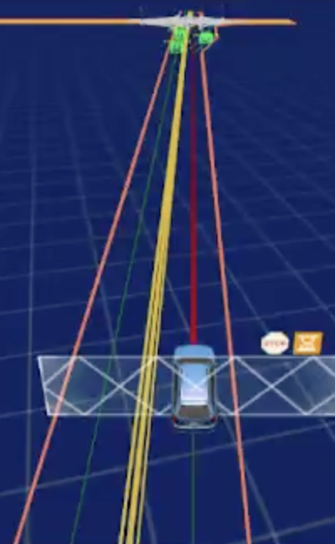
DoppelTest Evaluation
Doppelgänger
Testing
Evaluation
AV 1: Borrows lane to bypass AV 2.
AV 2: Idle.
AV 3: Idle.
Case Study: Unsafe Lane Borrow
AV 1
AV 2
AV 3
https://zenodo.org/record/7622399

Slide 33
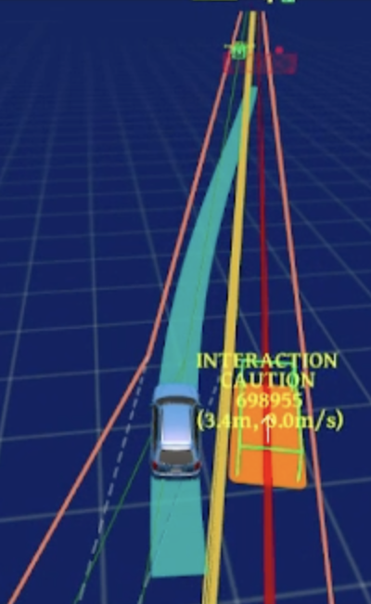
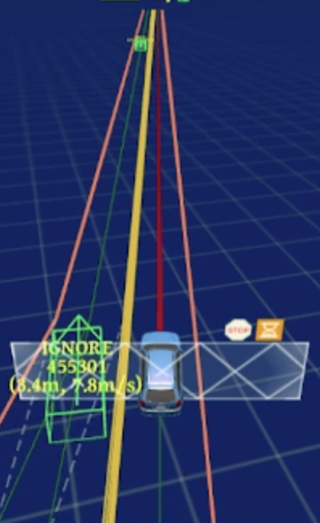
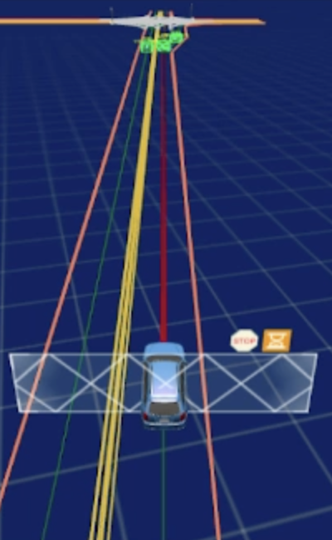
DoppelTest Evaluation
Doppelgänger
Testing
Evaluation
AV 1: Plans to return to its original lane.
AV 2: Idle.
AV 3: Idle.
Case Study: Unsafe Lane Borrow
https://zenodo.org/record/7622399

Slide 34
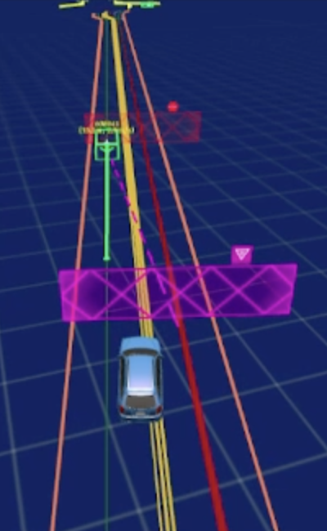
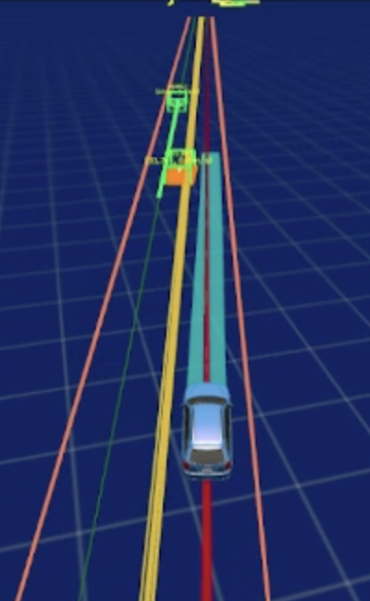
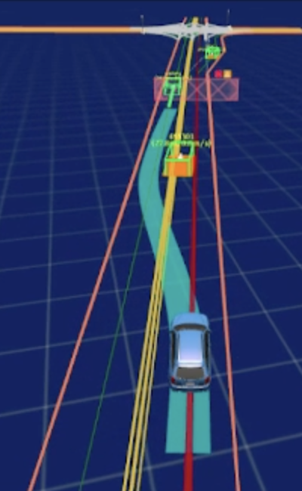
DoppelTest Evaluation
Doppelgänger
Testing
Evaluation
AV 1: Yields to incoming traffic (AV 3).
AV 2: Moving forward.
AV 3: Moving forward. Sees AV 1 blocking the lane. Plans to borrow lane.
Case Study: Unsafe Lane Borrow
https://zenodo.org/record/7622399

Slide 35
DoppelTest Evaluation
Doppelgänger
Testing
Evaluation
AV 2: Moving forward.
AV 1: Yields to incoming traffic (AV 3).
AV 3: Moving forward. Sees AV 1 blocking the lane. Plans to borrow lane.
Case Study: Unsafe Lane Borrow
https://zenodo.org/record/7622399

Slide 36
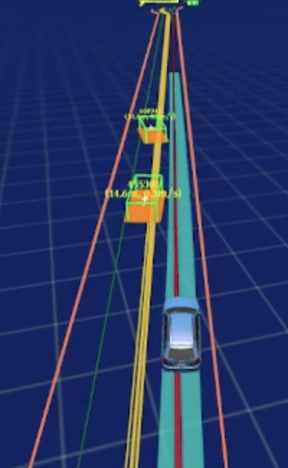
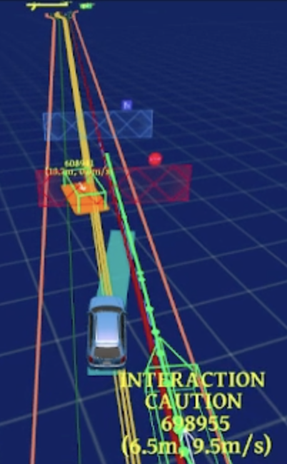
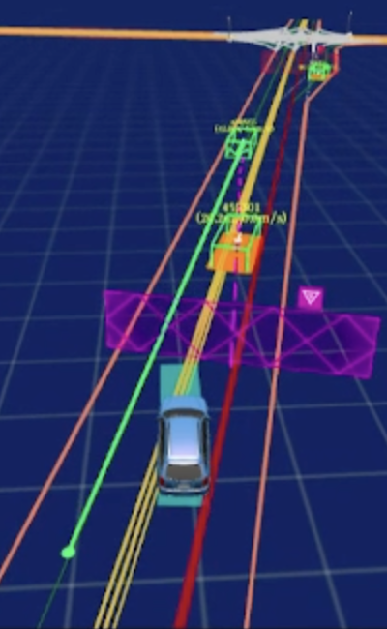
DoppelTest Evaluation
Doppelgänger
Testing
Evaluation
AV 2: Moving forward.
AV 1: Returning to lane. Plans to overtake AV 2.
AV 3: Realizes it cannot borrow lane. Yielding to AV 2.
Case Study: Unsafe Lane Borrow
https://zenodo.org/record/7622399

Slide 37
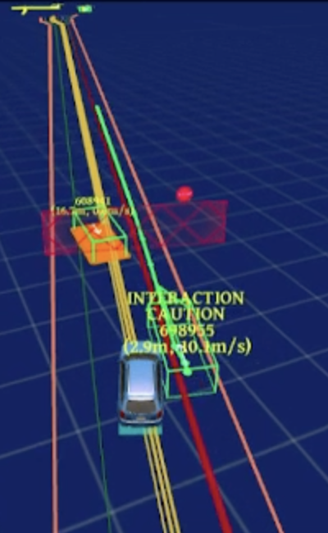
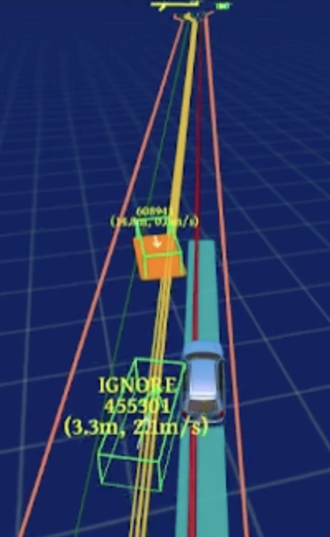
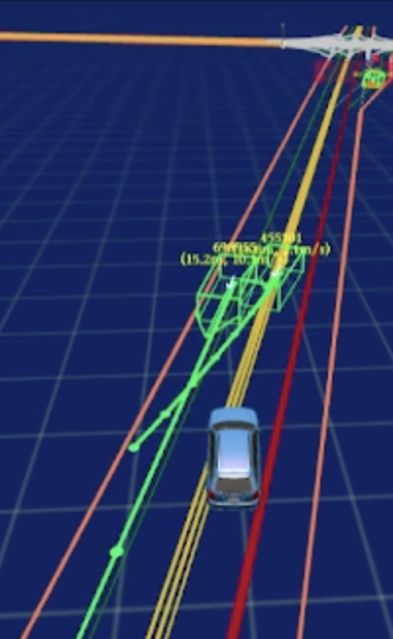
DoppelTest Evaluation
Doppelgänger
Testing
Evaluation
AV 1: Collision.
AV 2: Collision.
AV 3: Observing a BUG-REVEALING collision.
Case Study: Unsafe Lane Borrow
https://zenodo.org/record/7622399

Slide 38
DoppelTest Evaluation
Doppelgänger
Testing
Evaluation
Bug Description | Number
Stop sign rolling stop. | 33
Ignoring traffic light. | 5
Routing failure. | 2
Case Study: Planning Module Ignores Red Traffic Signal

Slide 39
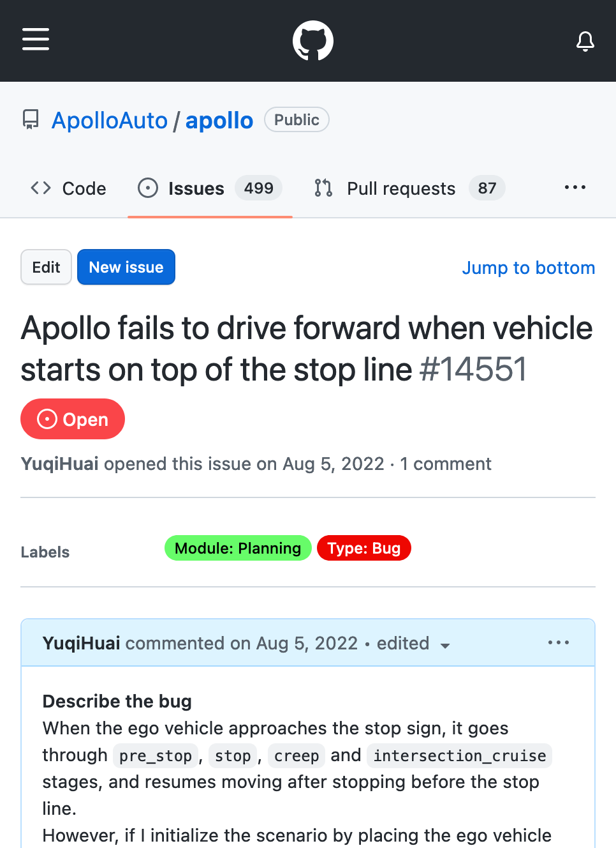
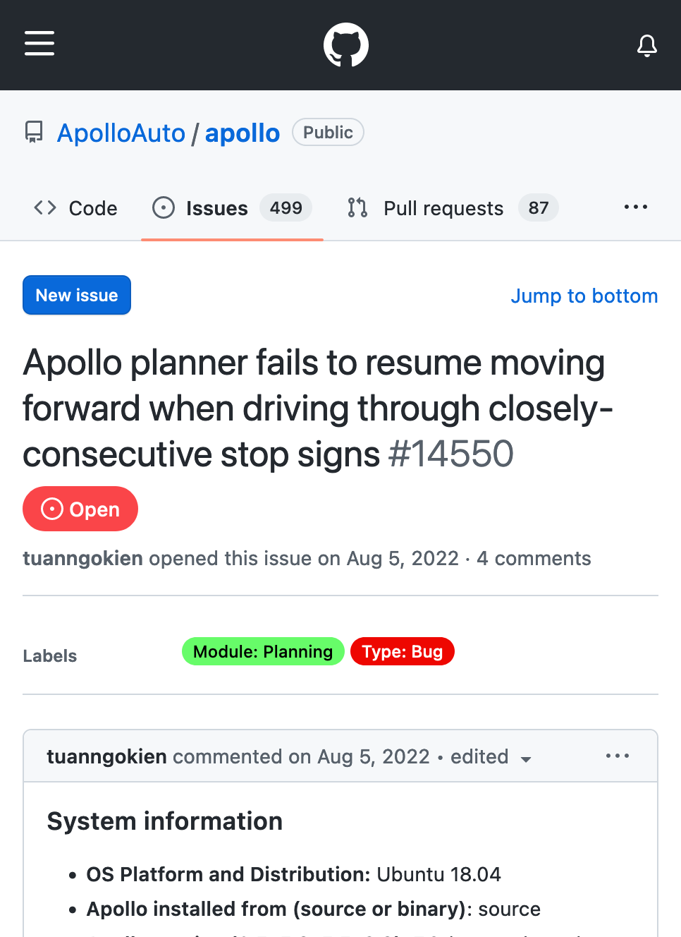
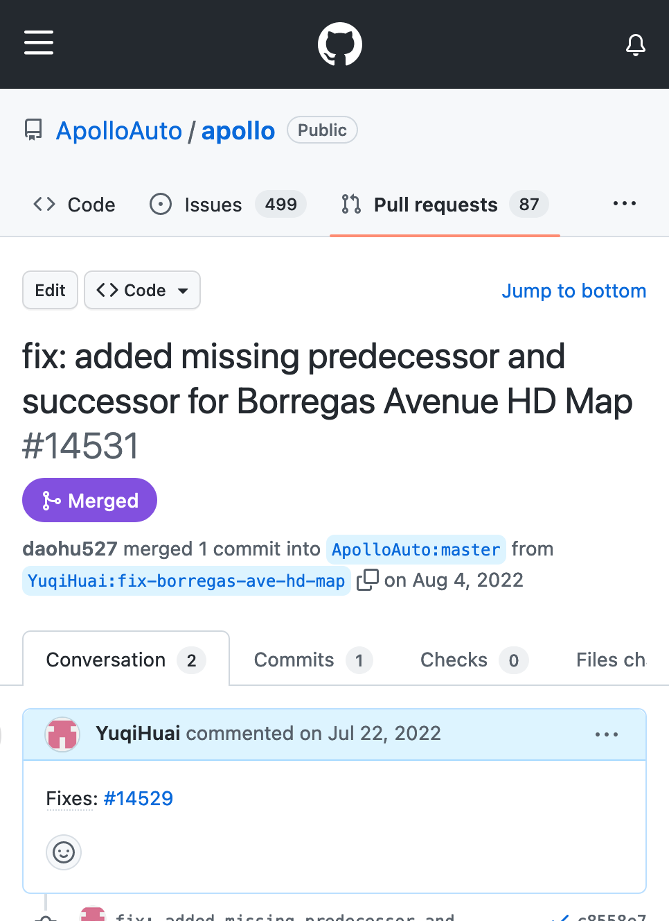
Confirmed bugs and issues
Issue/14551 (Confirmed)
Issue/14550 (Confirmed)
Pull/14531 (Fix Accepted)

Slide 40
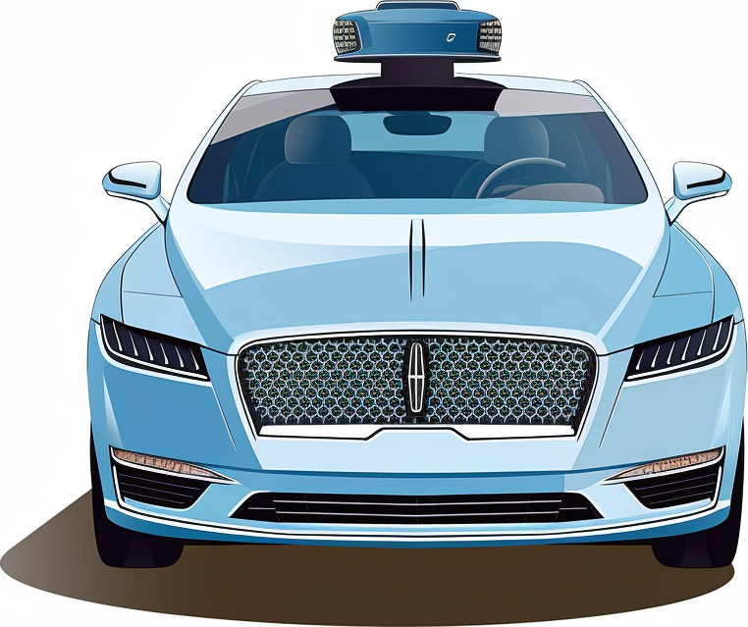
Summary
Doppelgänger Testing
Testing by observing the interaction between multiple instances of the ADS.
Guarantees ADS being responsible for any violation occurring.
DoppelTest
A framework that generates bug-revealing violations.
Discovered 8 unique bug categories in an high-autonomy open-source ADS.
Thank you! Any questions?

